Slide 1
Regression Testing

Slide 2
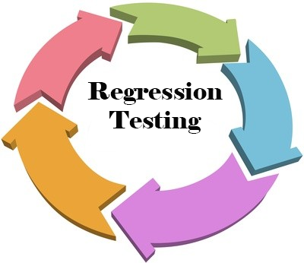

Slide 3
Regression testing is a type of software testing that verifies that software that was previously developed and tested still performs correctly after it was changed or interfaced with other software. Changes may include software enhancements, patches, configuration changes, etc.
The purpose of regression testing is to confirm that a recent program or code change has not adversely affected existing features.

Slide 4
Regression Testing is required when there is a
→Change in requirements and code is modified according to the requirement
→New feature is added to the software
→Defect fixing
→Performance issue fix

Slide 5
Regression Testing Techniques
Software maintenance is an activity which includes enhancements, error corrections, optimization and deletion of existing features. These modifications may cause the system to work incorrectly . Therefore , Regression Testing becomes necessary. Regression Testing can be carried out using following techniques:

Slide 6
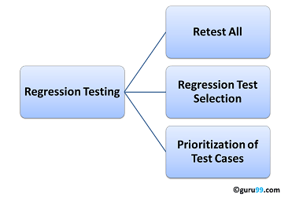

Slide 7
Retest All
This is one of the methods for regression testing in which all the tests in the existing test bucket or suite should be re-executed. This is very expensive as it requires huge time and resources.
Regression Test Selection
Instead of re-executing the entire test suite, it is better to select part of test suite to be run
Test cases selected can be categorized as 1) Reusable Test Cases 2) Obsolete Test Cases.
Re-usable Test cases can be used in succeeding regression cycles.
Obsolete Test Cases can't be used in succeeding cycles.
Prioritization of Test Cases
Prioritize the test cases depending on business impact, critical & frequently used functionalities . Selection of test cases based on priority will greatly reduce the regression test suite.

Slide 8
Goal of regression testing
→To assure that changes to the system have not introduced new errors that cause the system to regress.
Example:
An interesting act between a doctor and a patient who was initially suffering from stomach ache and later on stared suffering from mouth ache due to overdose of tablets that were give to cure stomach ache.

Slide 9
Patient: Doctor ,I am suffering from indigestion.
Please check.
Doctor: ok..Take these ¾ types of tablets and come for recheck up after 3 days.
Doctor: Congratulation! The stomach ulcer that was bothering you and preventing digestion is now completely cured.
Patient: That is fine, doctor but now ,I have got such a bad mouth ulcer because of taking so many types and number of Tablets. Now ,I am not able to eat anything and so, there is nothing to digest.

Slide 10
Activities of Regression Testing:
→Identify the basic function of the product.
→Design test cases for these basic function.
→Every time the changes is done, ensure that the product runs successfully with no side effects.
Types of Regression Testing:
Final Regression Test.
Regular Regression Tests.

Slide 11
Advantages of Regression Testing:
1)Detecting Bugs
2) Detects undesirable side
3)New way

Slide 12
Agile Testing

Slide 13
Example:
An interaction between a government employee and a citizen who is asking for his grandfathers death certificate.
Citizen: Excuse me sir ,is the certificate ready.
Govt.Servent: Yes it. But we require the person, whom the certificate is issued, to come and sign the form.
Citizen: But sir, this is impossible. He can never come here.

Slide 14
Govt.Servent: oh. Sorry. Then, we cant issue the certificate. This is our legal process that the person himself should be present to take his certificate as we need his received sign for acknowledgement.
Citizen: I understand your process, sir. but I am asking you for a death certificate of my grandfather. How can I bring him here?

Slide 15
Advantages of Agile Testing:
1)Continuous Process
2)Involve
3)Clean of Bugs
4)Documentation
5)Implemented and Tested
Disadvantages of Agile Testing:
1)As bug fixes and releases happen more often, more number of regression bugs may be introduced.
2)Test team may not work on developing a consistent and powerful test system that can be main

